Slide 1



Case Study On BookMyShow
B.P.C.C.S. GANDHINAGAR
GROUP NO.2 :-
1. Pratham Parmar
2. Kuldip Prajapati
3.Kishan Bhatt
4.Vishw Patel
5.Visha Patel

Slide 2
About Book My Show
Ashish Hemrajani Started Bigtree Entertainment Pvt.Ltd in his bedroom in 1999
Parikshit Dar took over technology & Rajesh Balpande took over Finance and both came in as Co-Founders
1st Investor – JP Morgan Chase
Go For Ticketing
Book My Show
India Ticketing (2002)

Slide 3
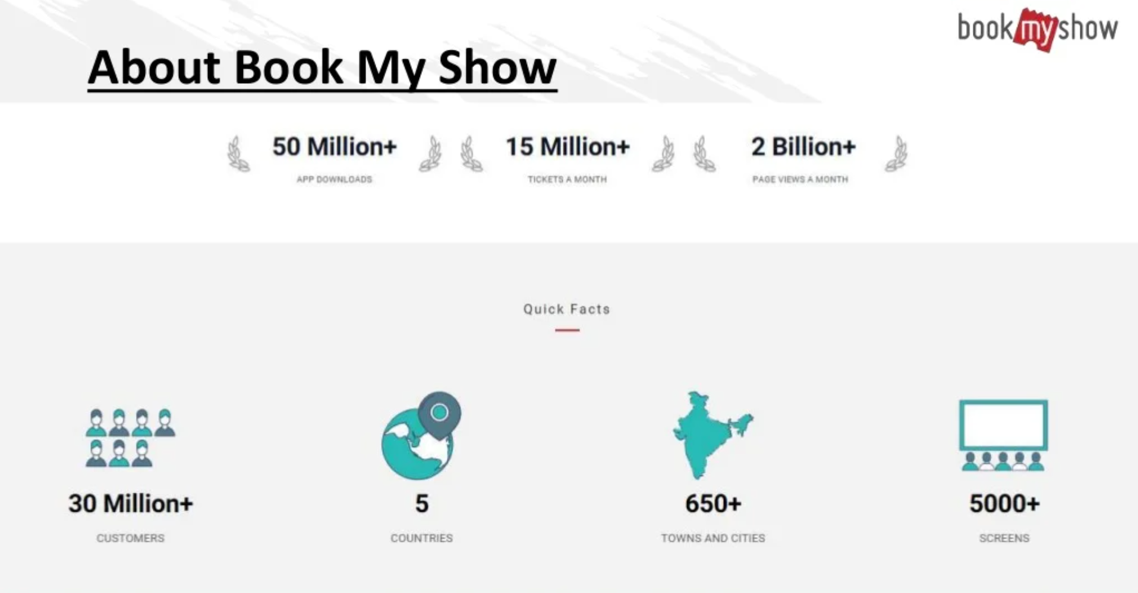

Slide 4
Service Based
It provides event ticket before the show online.
Movie Ticket
Event Ticket (Comedy shows , Meetup etc)
Meals

Slide 5
Technical Specification :
A. Website :- https://in.bookmyshow.com/
B. App :- Book My Show.
C. Devloped in :- Html ,CSS , JavaScript, MySQL.

Slide 6

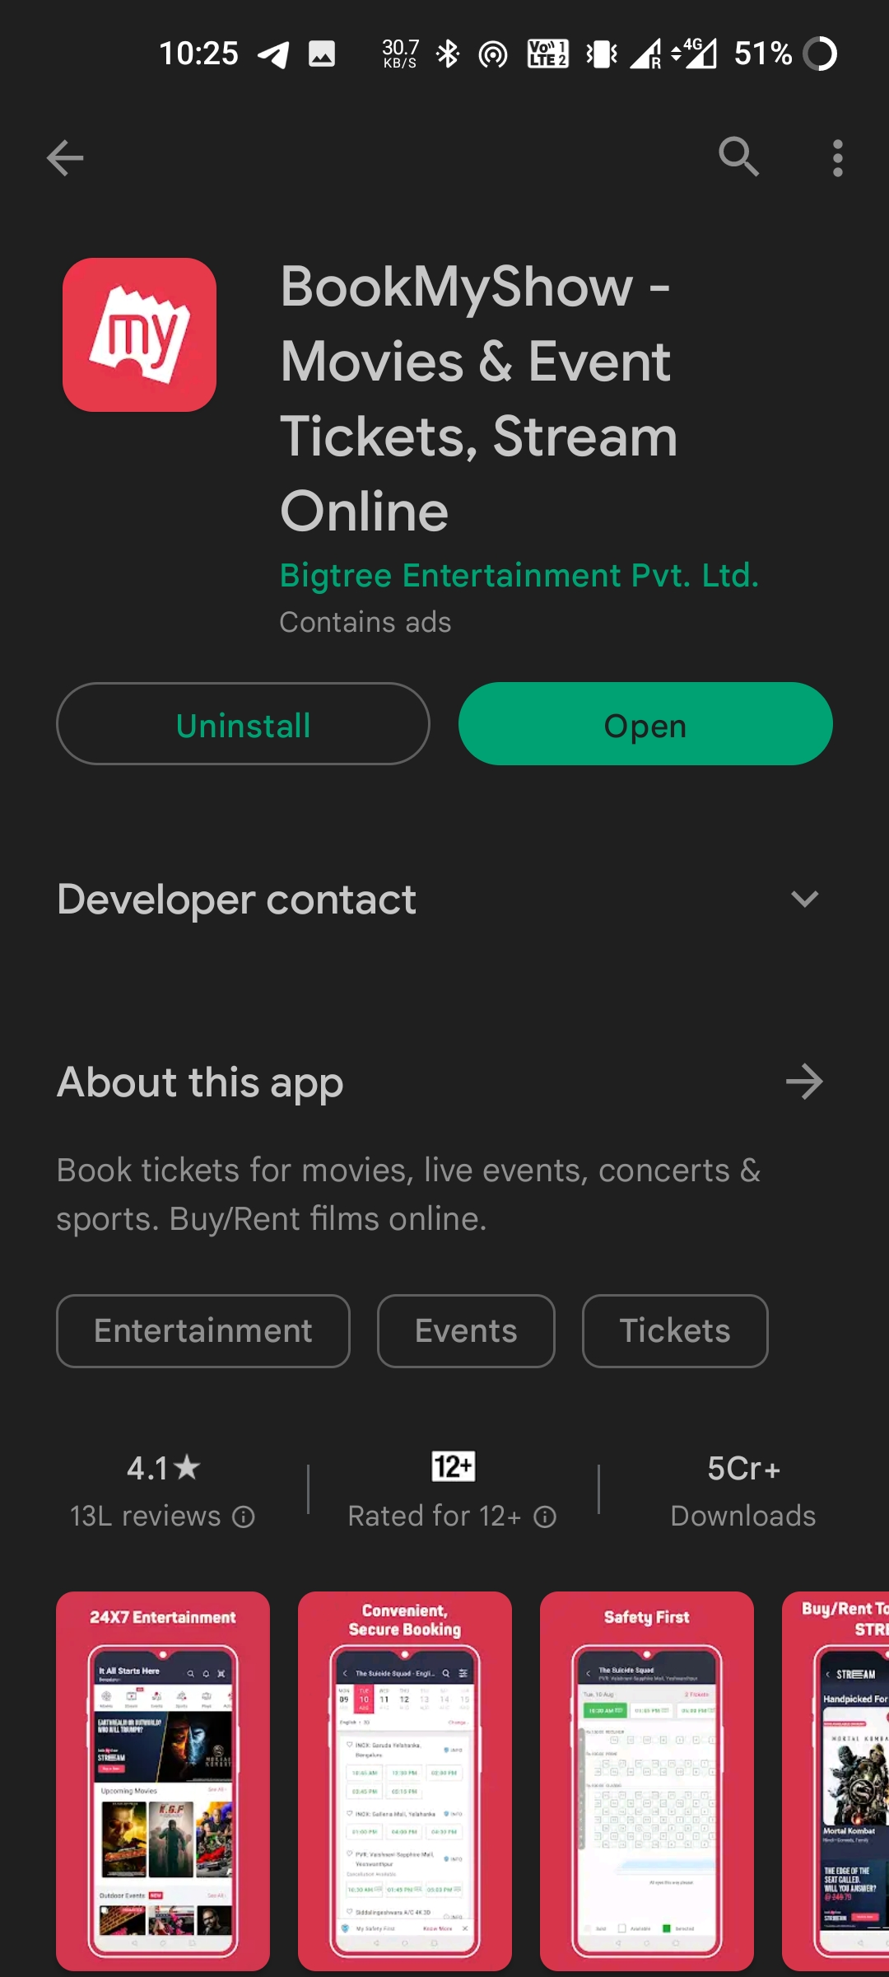
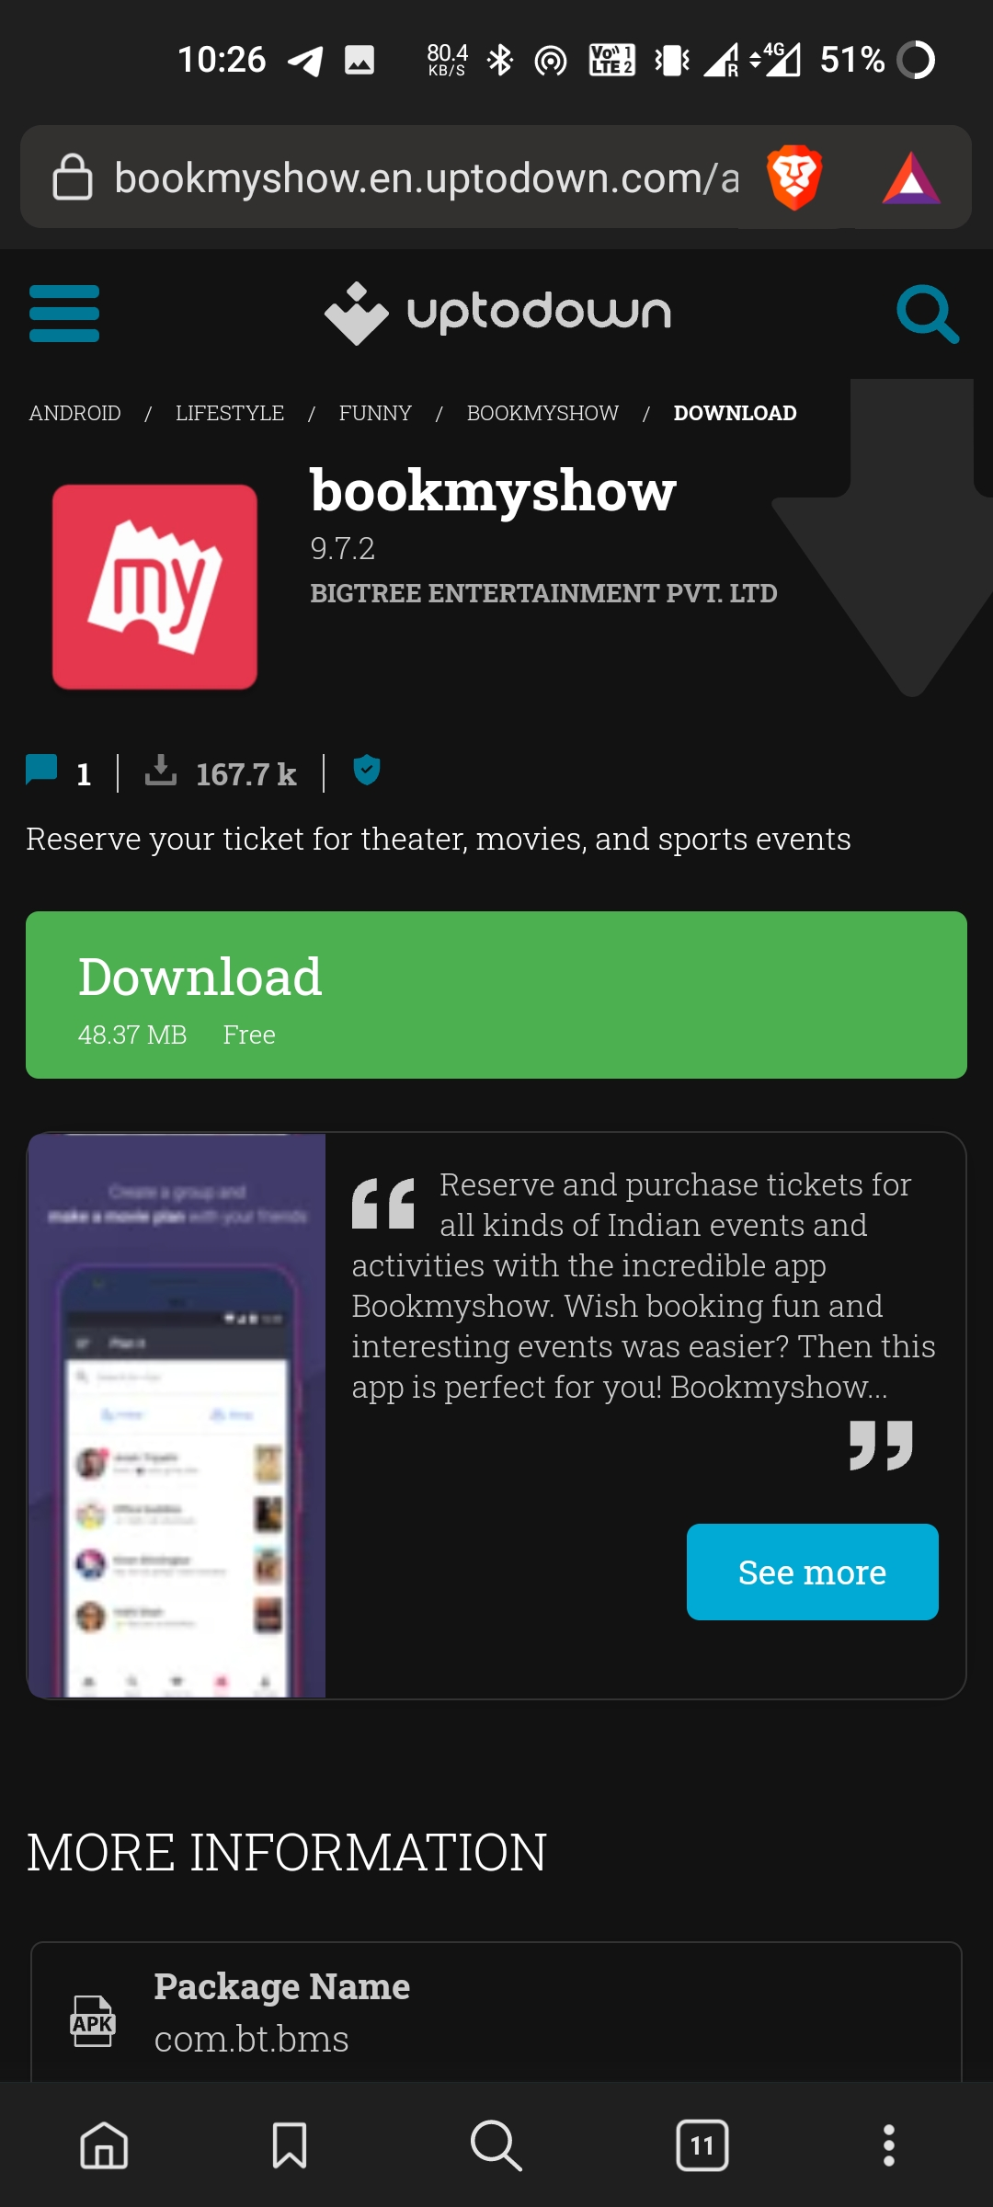
You can download it from Play store or from direct website
ROLE OF CUSTOMER :
Play store
Website

Slide 7
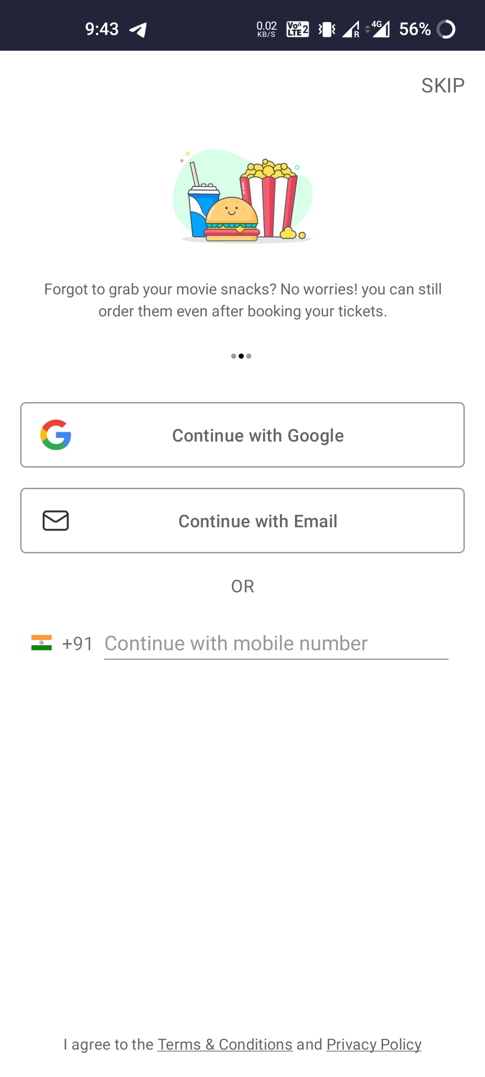

Login page
There are total 2 Ways to Log into in.
Google Account O.T.P. Method.
Mobile number
You can also skip it for now.

Slide 8
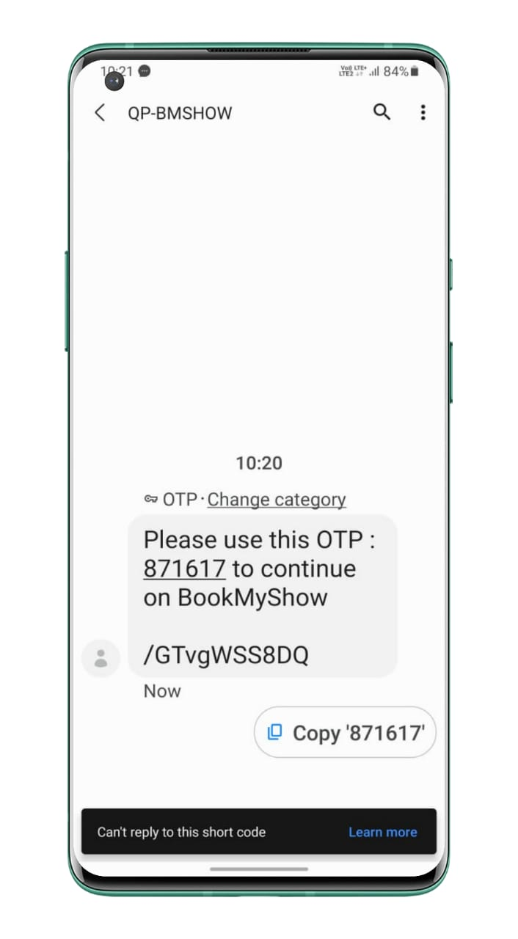
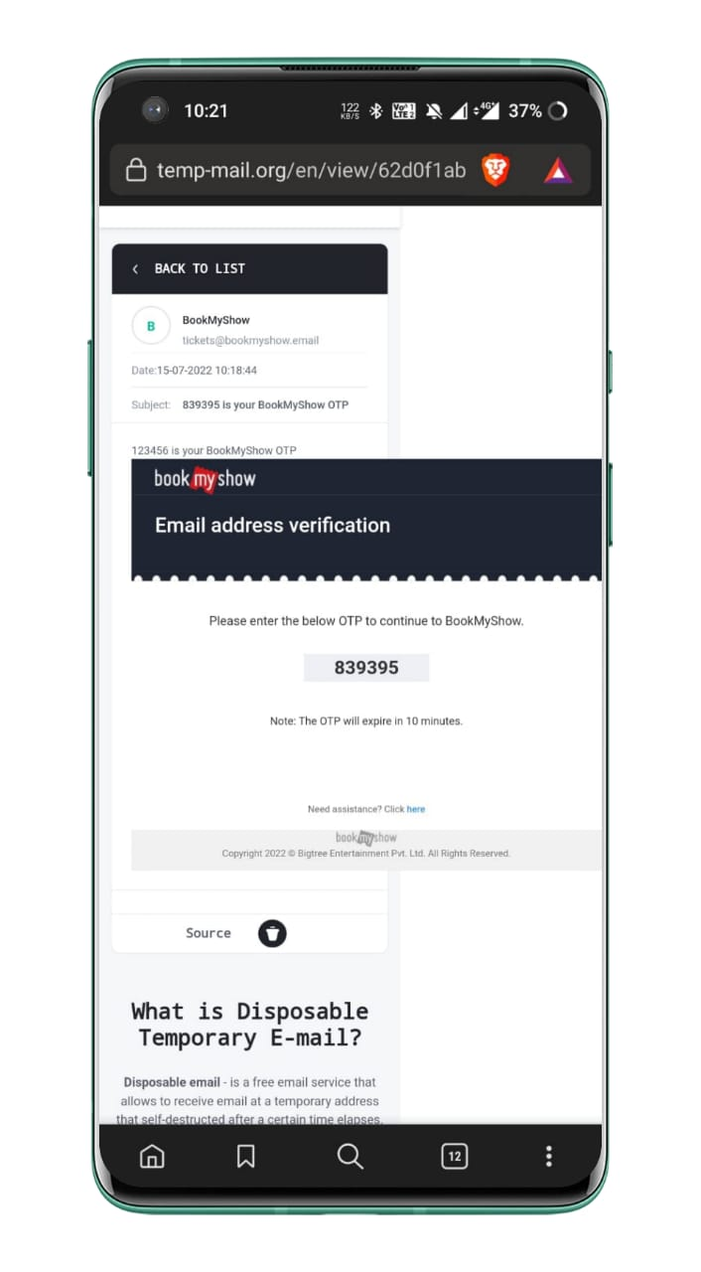
OTP METHOD
Phone no Gmail

Slide 9
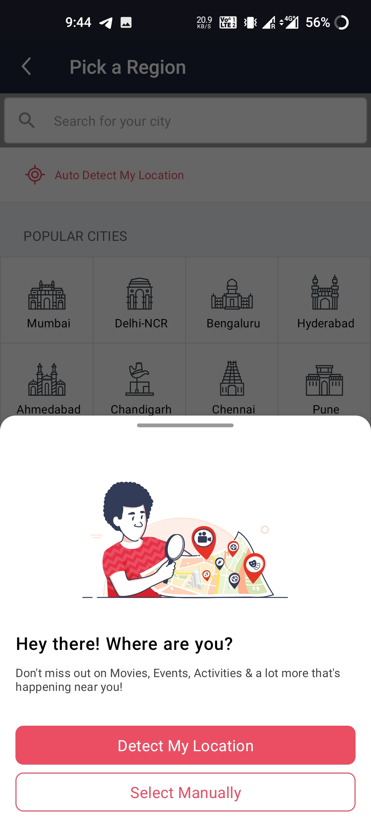

LOCATION
After Login It will Ask you to enter your location
There are two ways to feed it location
Detect My location automatically By GPS
Select Manually
It will use your location to show you nearest cinema hall

Slide 10
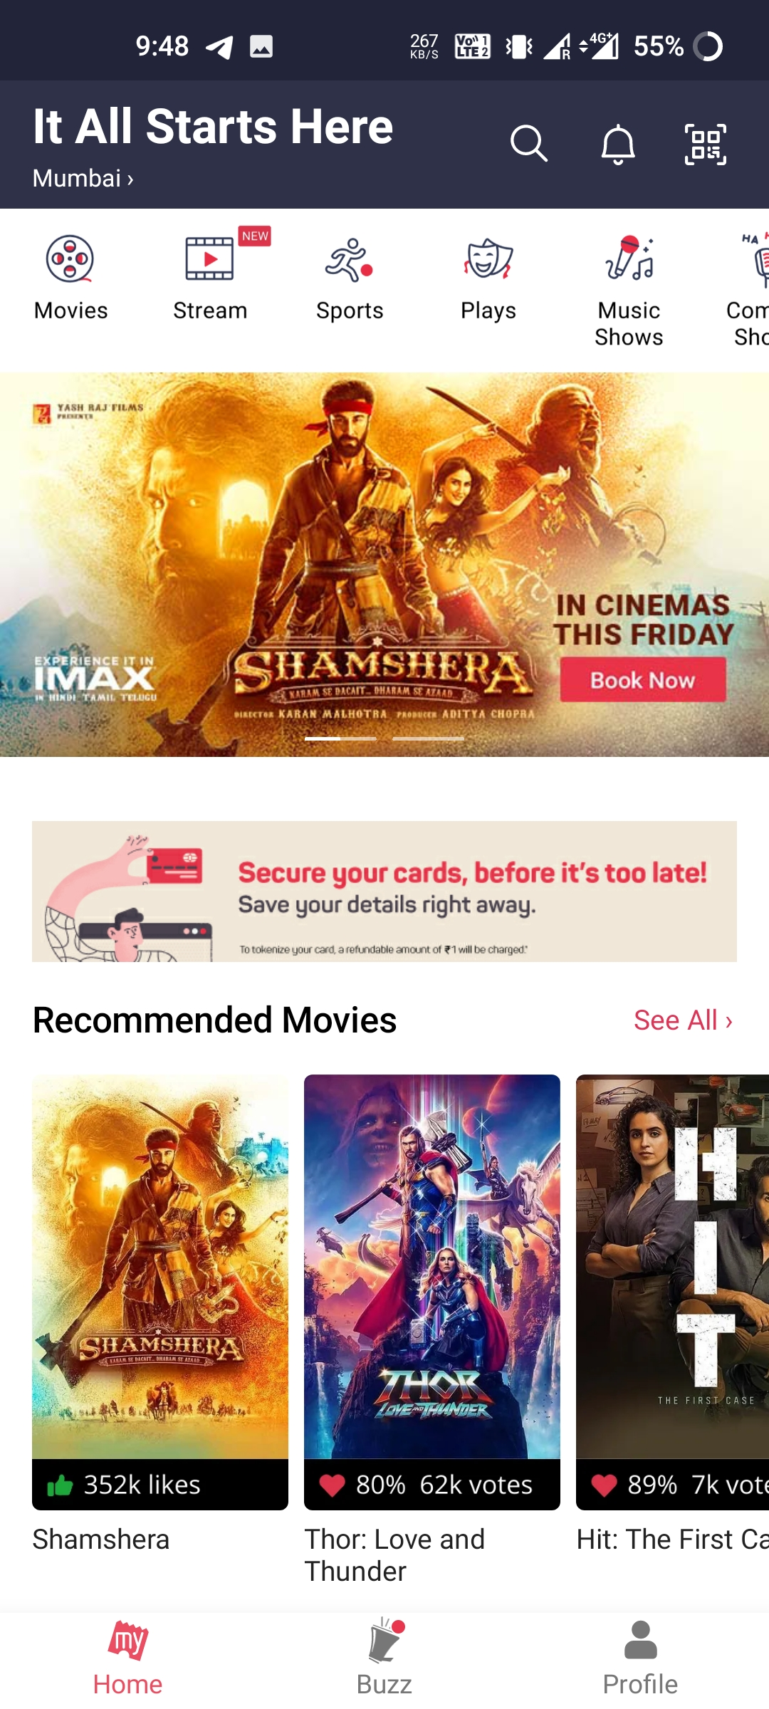
HOME PAGE
In home page you will find so many options such as booking ticket or watch the movie online etc.
On home page shows multiple option on upper side like live streaming ,sports, comedy, music shows.
It also provide workshop and kids zone.
You will find :-
A search button
Recommended movies
Q.R. code scanner

Slide 11
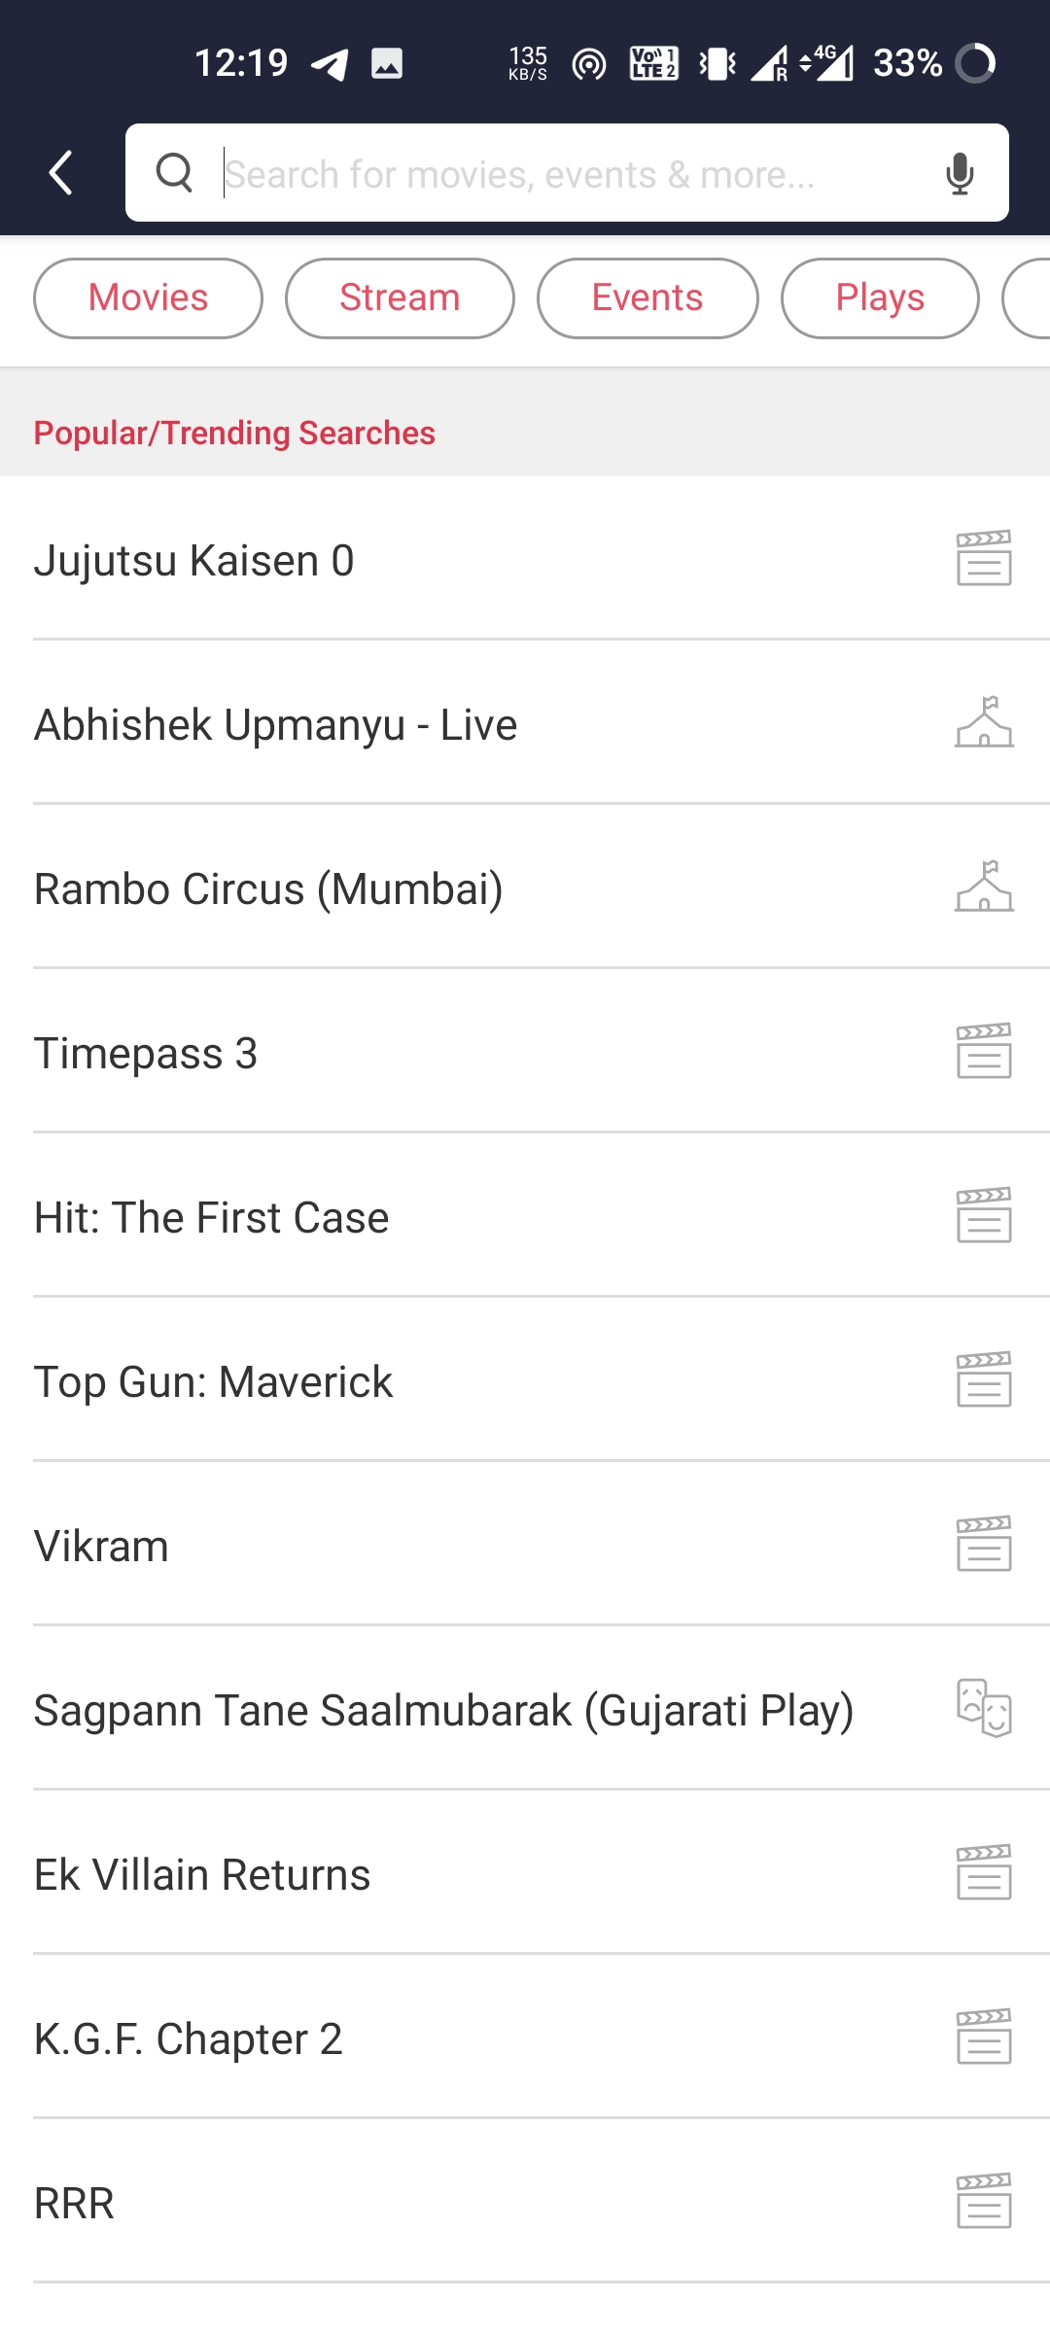

SEARCH
You can search movie , cinema hall , Events etc.
It will also recommend you trending events and movies.
Select What You want.

Slide 12
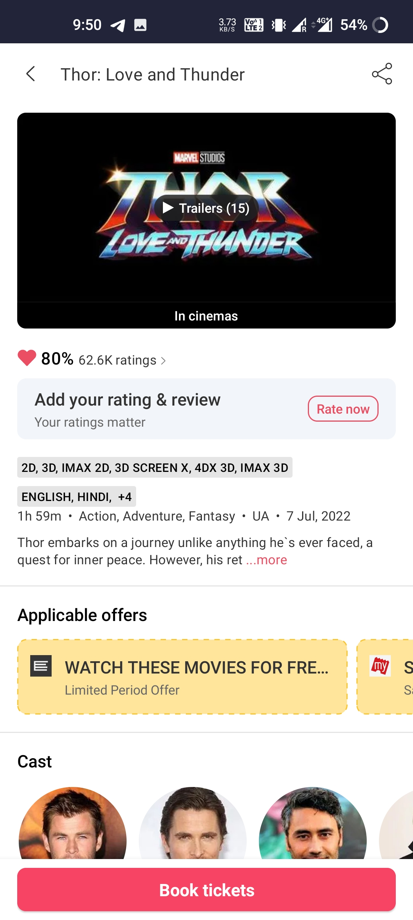

BOOKING TICKET
After selection , You will have the quick detail of the show.
In detail you find Short Information about the show.
To book The ticket Press on the bottom button ‘book tickets’ .

Slide 13
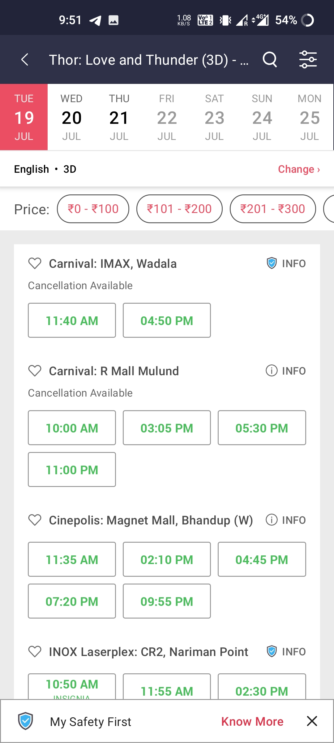
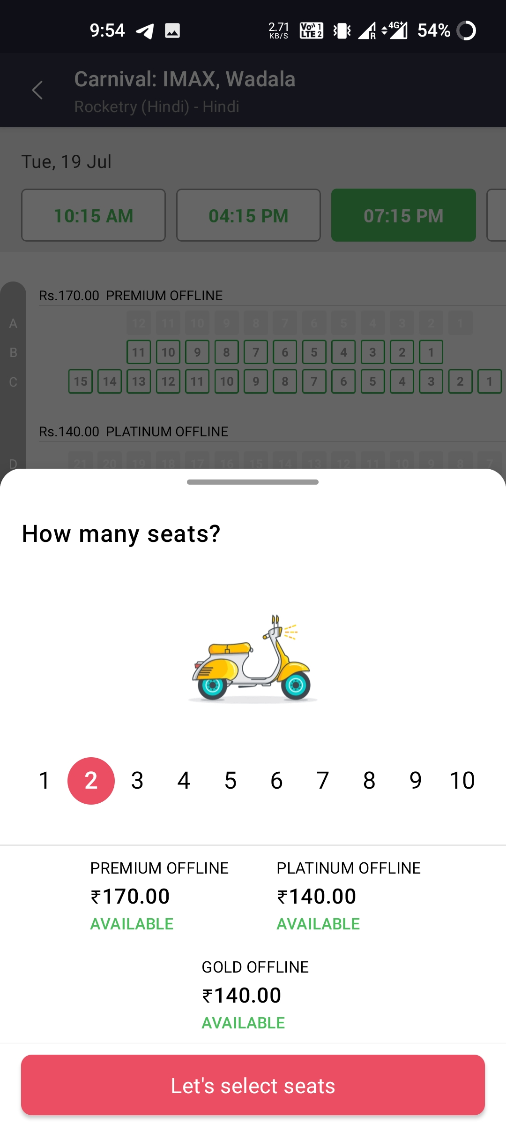
Date ,time And Cinema hall Choosing
Now you have to select Time, Hall and date according to your comfort.
Here also have filters for accurate result.
Then select seats And it will show you the total amount and various selections.

Slide 14
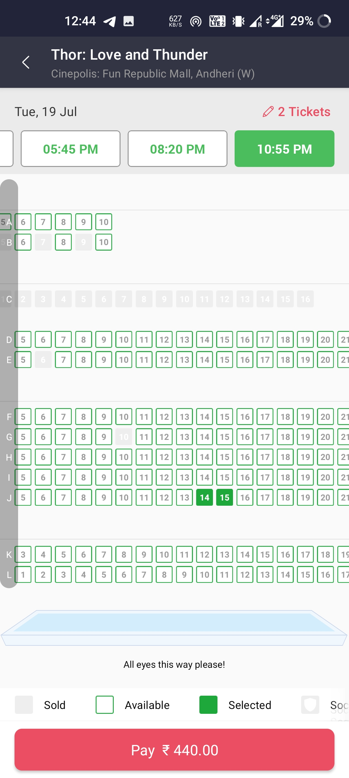
Seat selection
Here, You can select seats you want.
If seats already booked then it show in red color available seats show in green color.
Here, we can see date and time of the movie as well as screen direction.

Slide 15
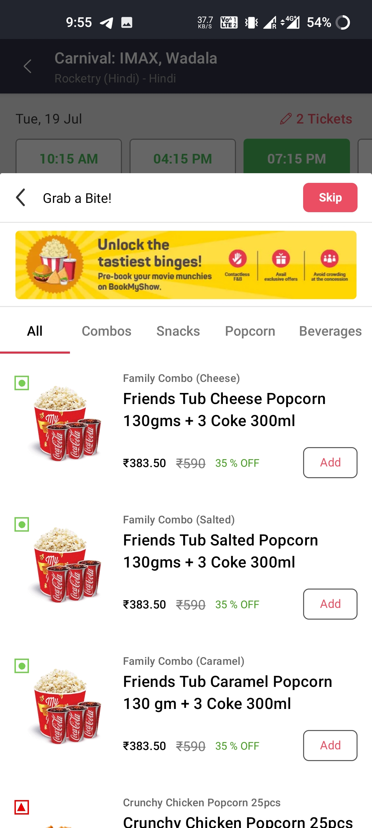

Pop up
A screen will pop up like this , to ask you about beverages.
If you want it then Choose What you want Otherwise you can skip it.

Slide 16
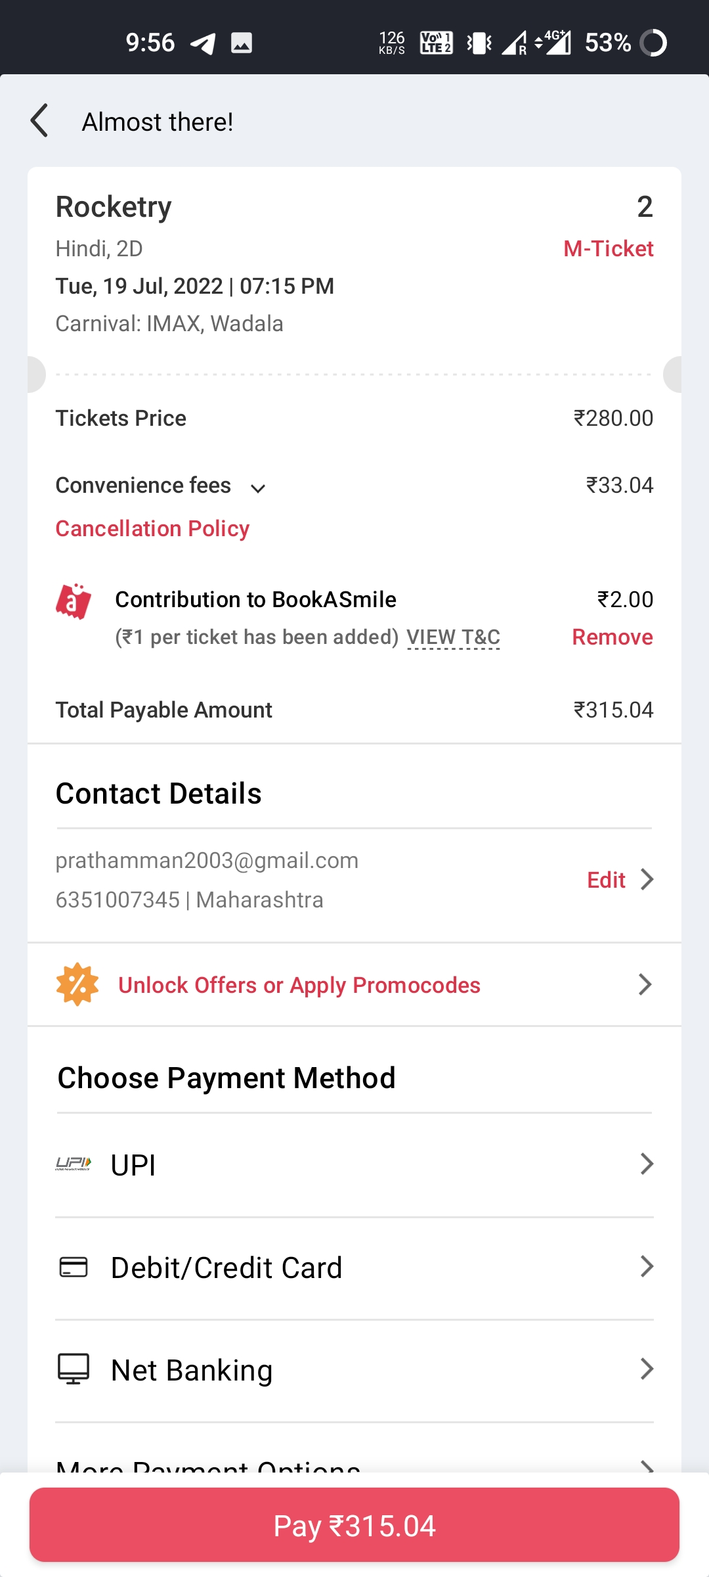

Invoice
Here we have the invoice of the ticket with every possible details.
Also we have several payment options.
Also some offers.

Slide 17
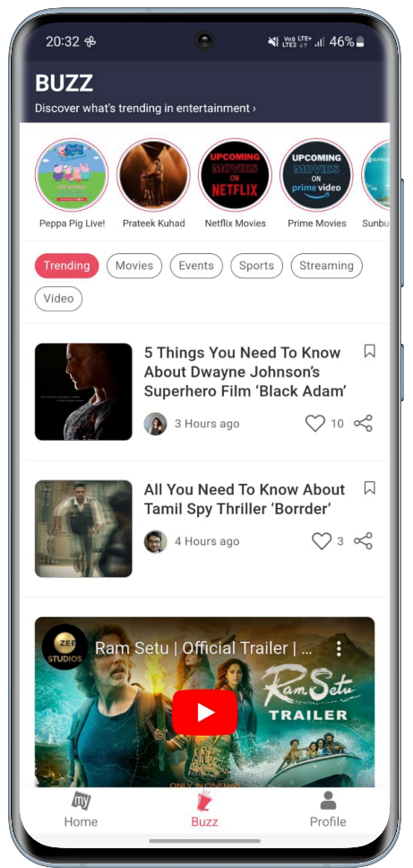
Buzz Services
Buzz services are used to discover what’s trending in entertainment
Buzz discovered are below
Trending
Movie
Event
Sport
Streaming
Video

Slide 18
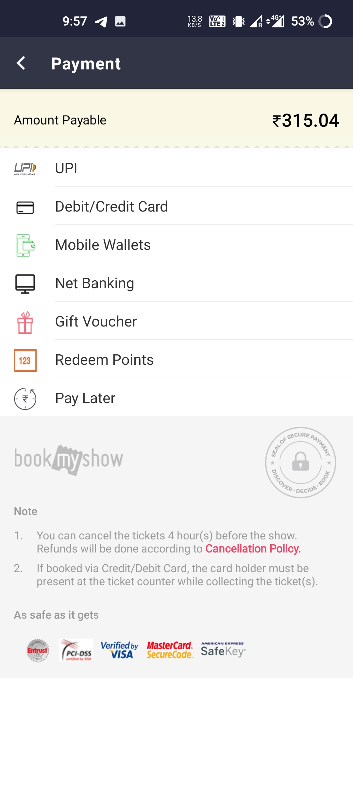
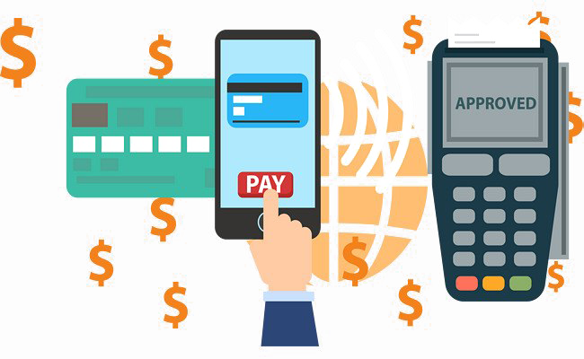
Payment methods
Here , we have the several payment options .
UPI.
DEBIT/CREDIT CARD
MOBILE WALLETS
NET BANKING
GIFT VOUCHER
REDEEM POINTS
PAY LATER – Where you can pay the amount at venue.

Slide 19
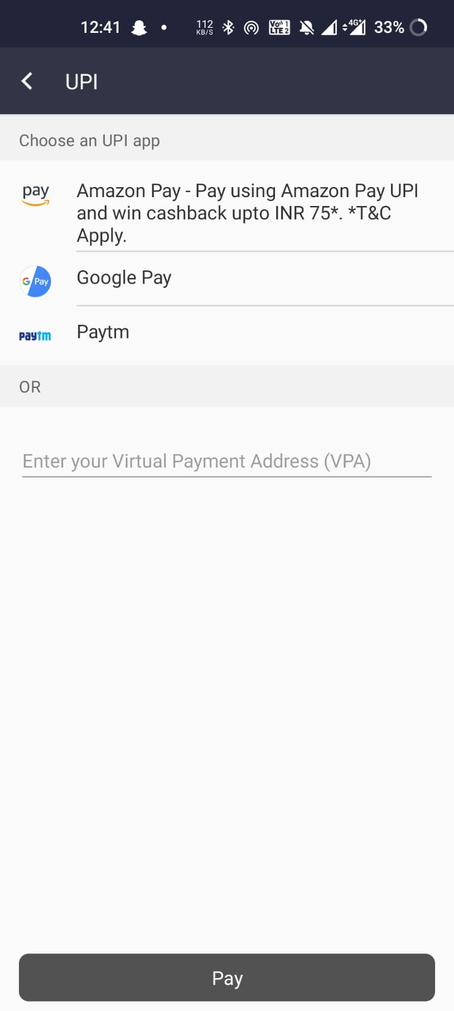
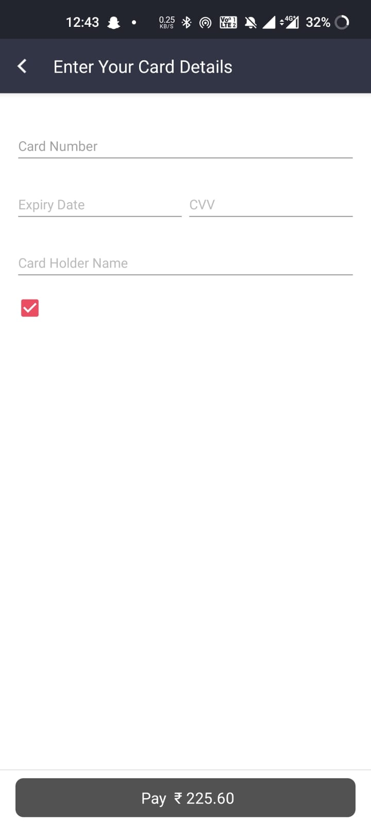
MULTIPLE PAYMENT OPTIONS
UPI PAYMENT OPTION
PAYMENT OPTIONS THROUGH DABIT/CREDIT CARD

Slide 20
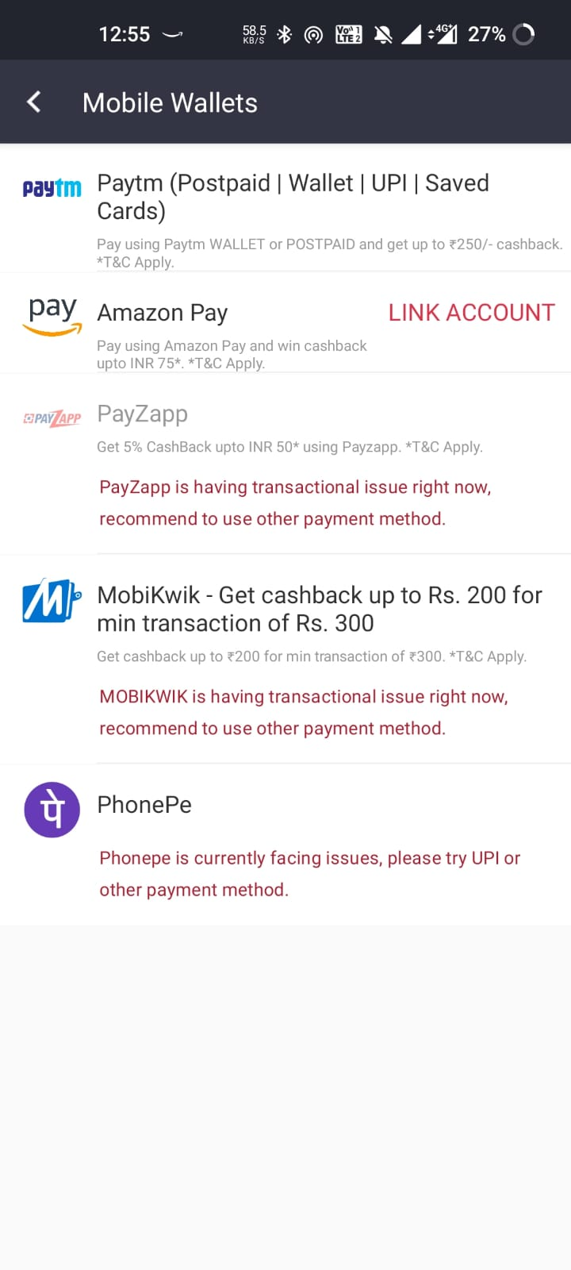
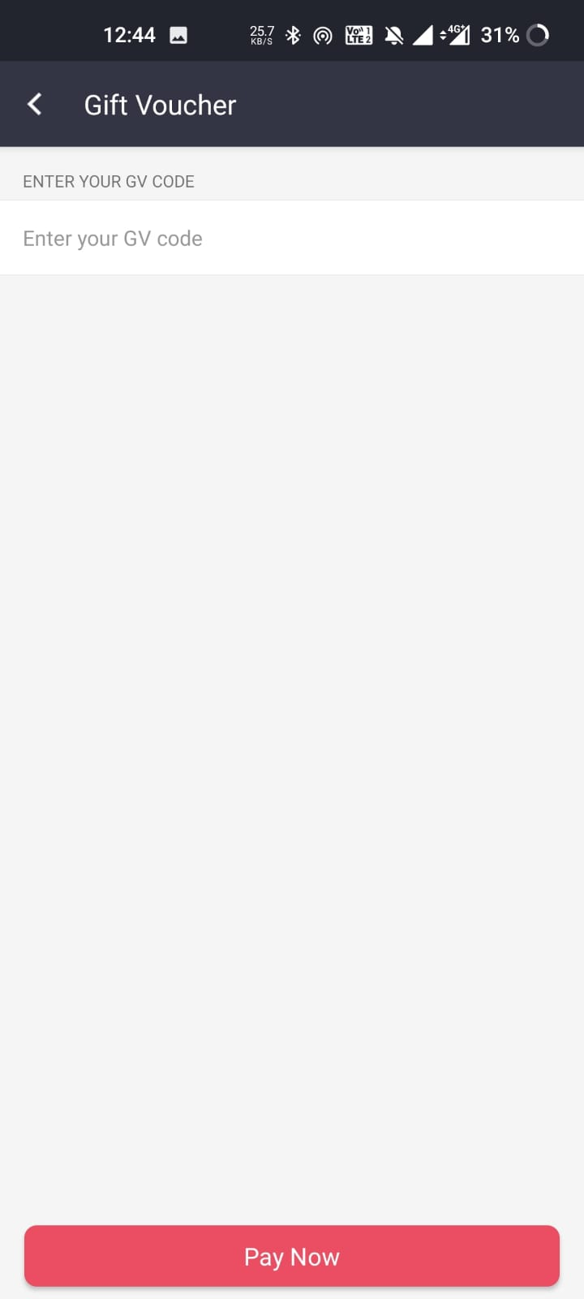
MULTIPLE PAYMENT OPTIONS
PAYMENT THROUGHT MOBILE WALLET
PAYMENT THROUGHT GIFT VOUCHER

Slide 21
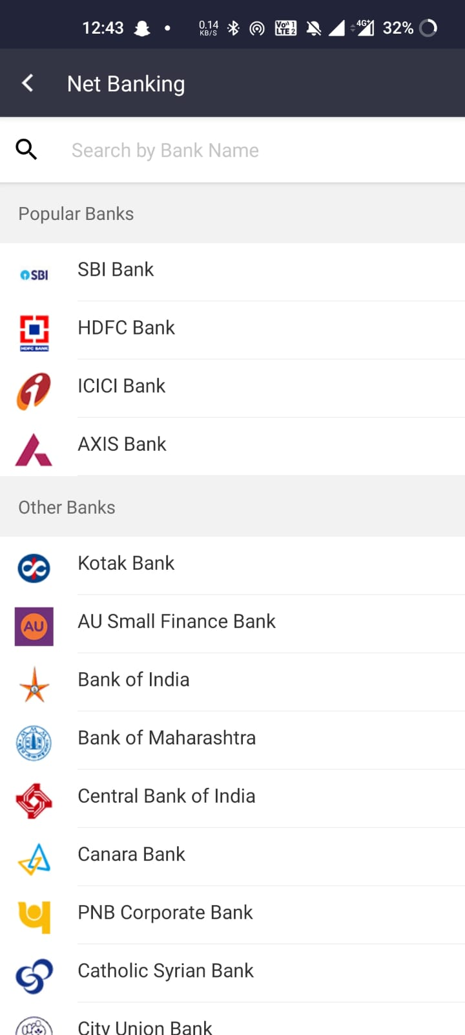
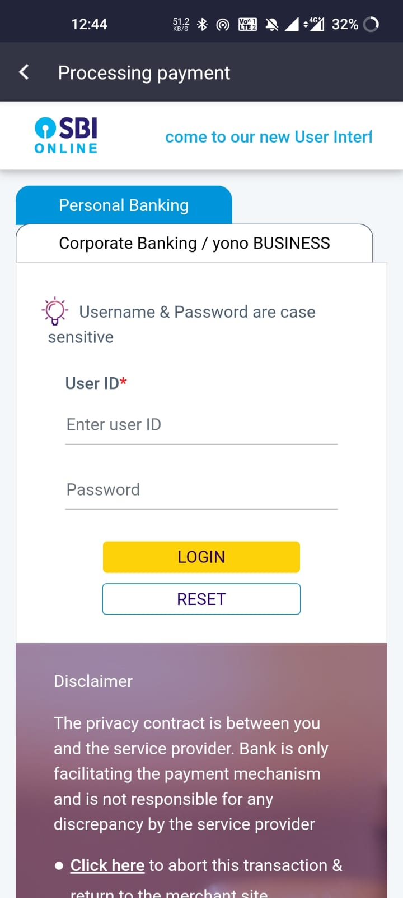
NET BANKING
AFTER ALL WE HAVE MANY PAYMENT BANK
FOR EXAMPLE IF WE SELECT SBI BANK THEN IT WILL PROCEED US TO SBI’S PORTAL

Slide 22
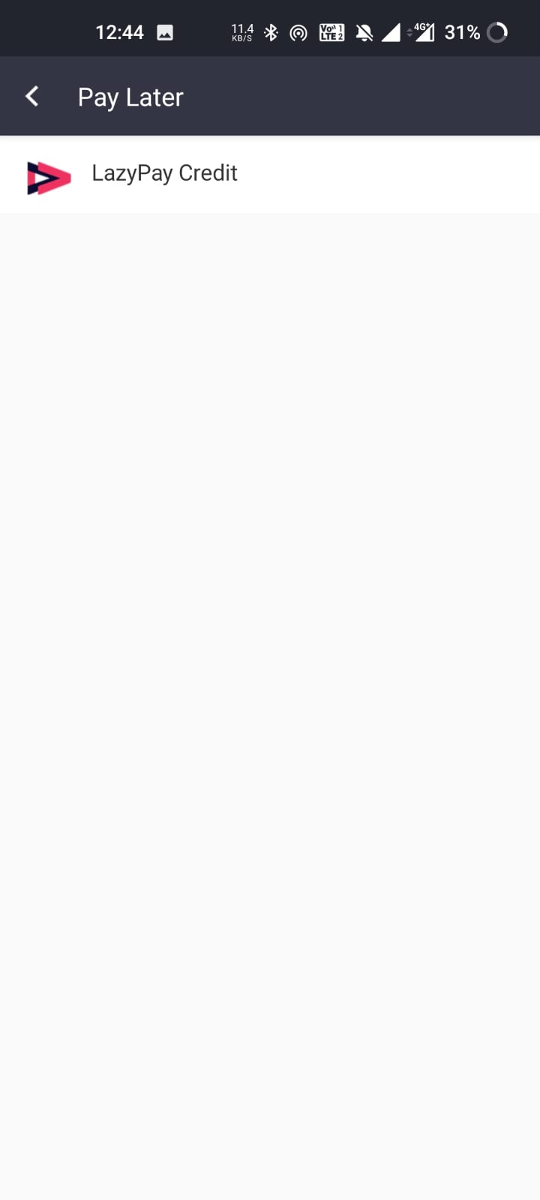
Pay later option
We have a pay later option in which , we can pay money later , on credit

Slide 23

CanceLlation process
You can cancel the tickets 4 hours before the show and refund will be done according to Cancellation policy.
If you booked via Credit/debit Card ,the card owner must be present at time of ticket taking.

Slide 24
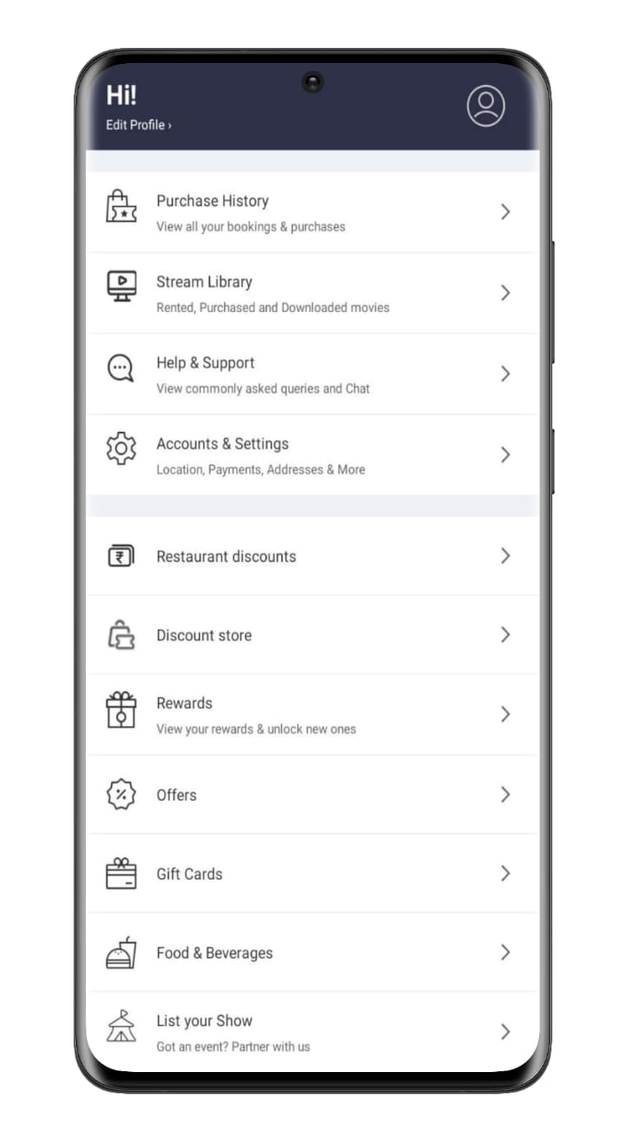

Profile
In profile section we found many option such as:-
Purchase History
Reward
Restaurant Discounts
Discount stores
Offers
ETC.

Slide 25

HOW TO REGISTER YOUR SHOW IN BOOK MY SHOW?
Role of Seller :-

Slide 26

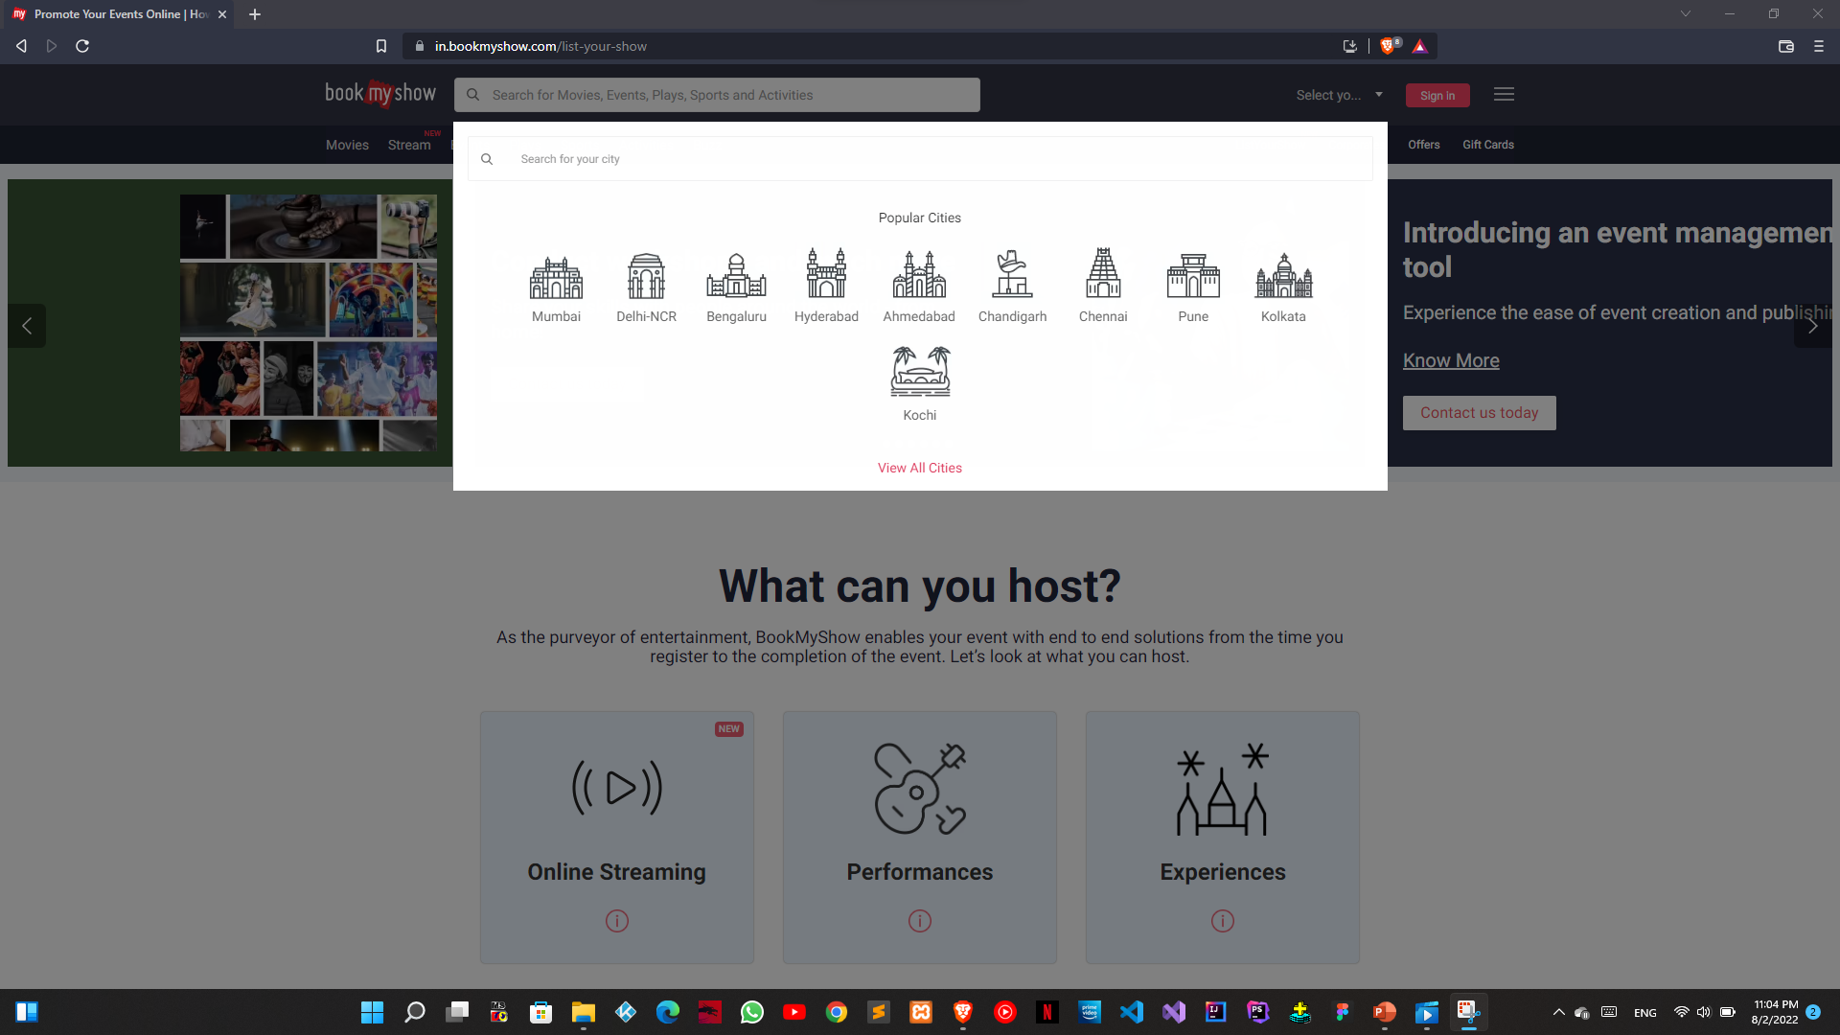
CITY SELECTION
FIRST OF ALL YOU HAVE TO SELECT CITY WHERE YOU WANT TO DO YOUR PROGRAM OR YOUR THEATER LOCATION.
AFTER SLECTION IT WILL REDIRECT TO THAT CITY PAGE

Slide 27
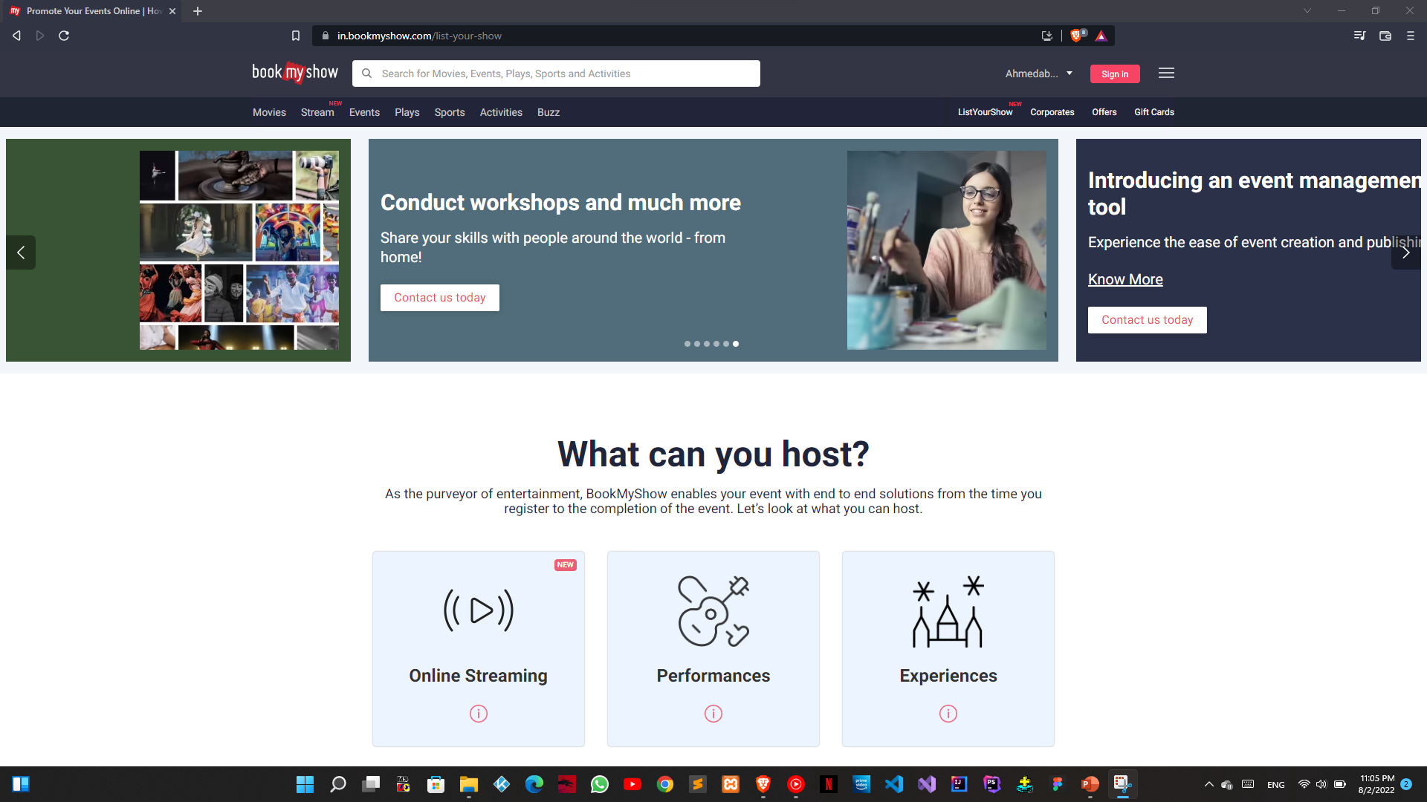
MAIN PAGE
AFTER SELECTION OF CITY YOU WILL BE DIRECTED TO MAIN PAGE WHERE YOU WILL FIND MANY OPTIONS.
SOME DETAIL OF HOSTING AND ETC.
ALSO, YOU CAN BOOK MOVIEW TICKET FROM HERE.

Slide 28
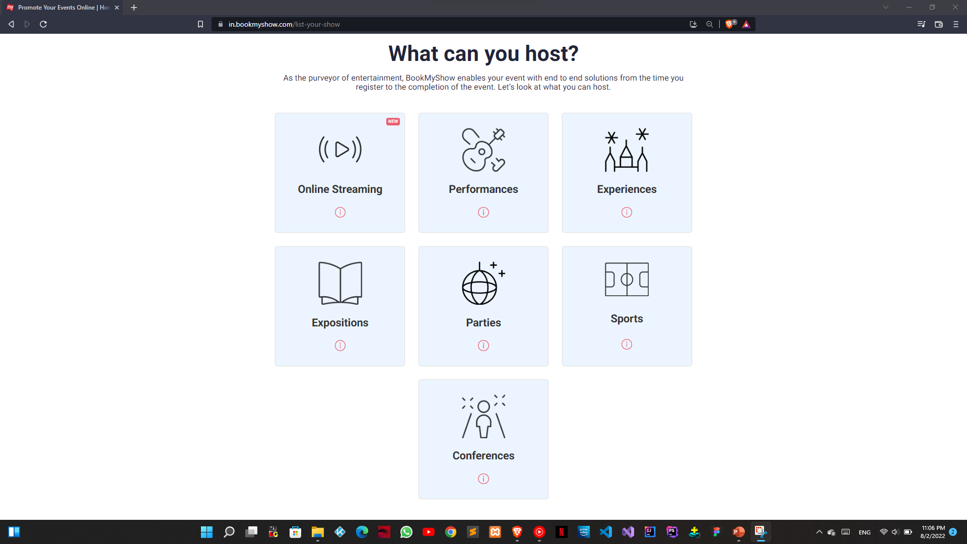
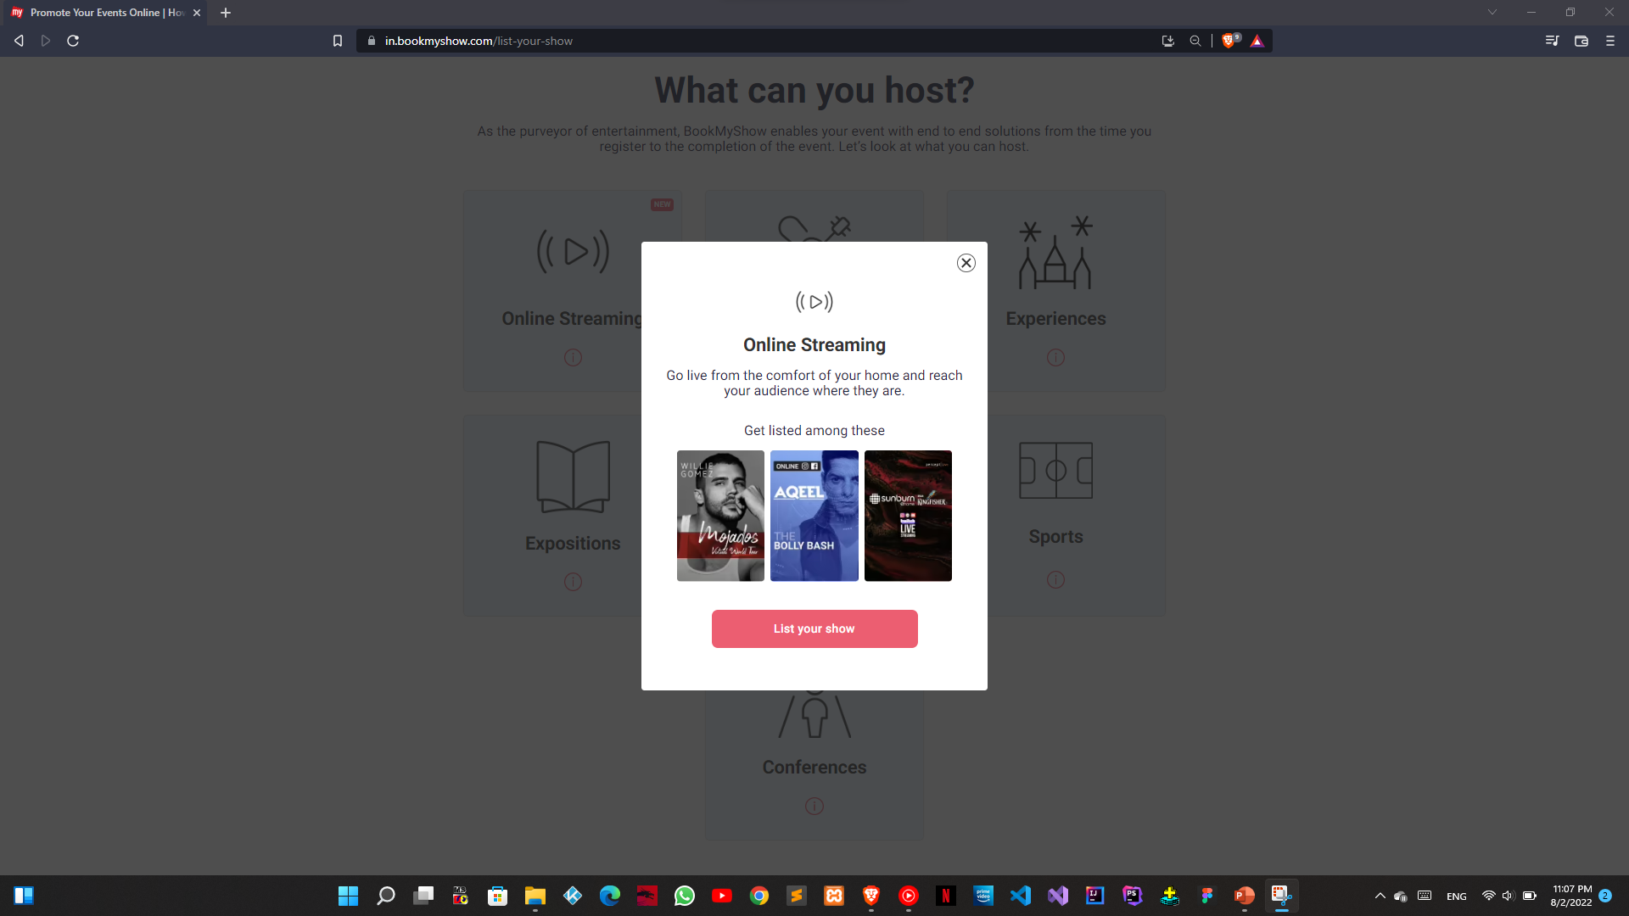
HOSTING DETAIL
SOME DETAIL ABOUT HOSITNG , SUCH AS WHAT CAN YOU HOST ETC.

Slide 29
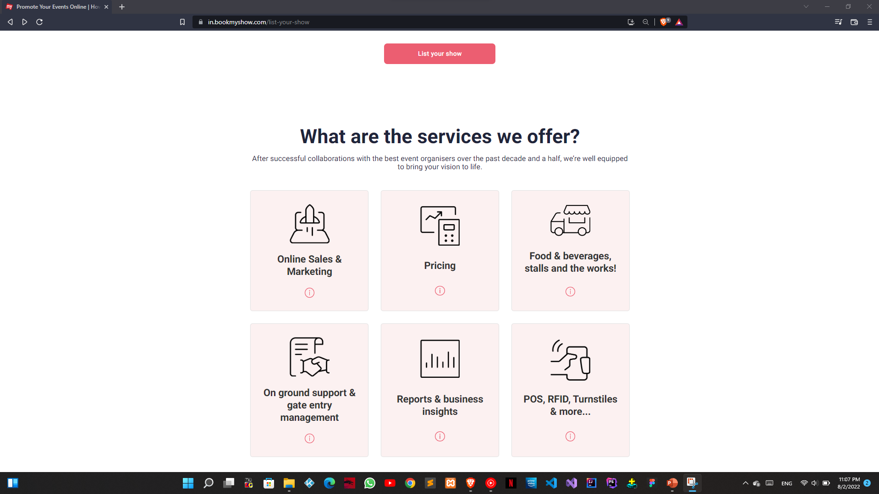

SERVICES AND LIST BUTTON
HERE, WE HAVE SOME DETAIL OF SERVICES
AND A BUTTON WHICH REDIRECT YOU TO REGISTER PAGE

Slide 30
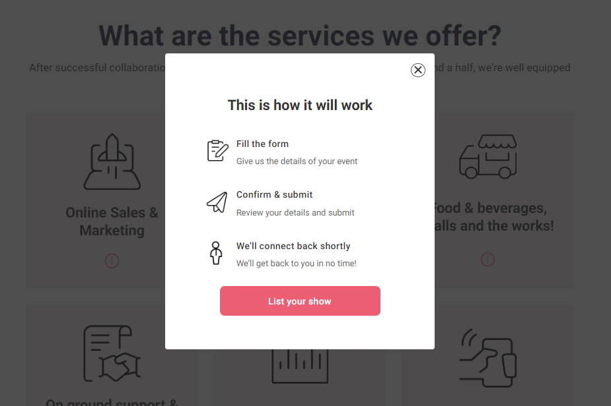
CONFIRMATION PAGE
AFTER CLICKING ON LIST YOUR SHOW IT WILL SHOW YOU A CONFIRMATION ..
JUST LIKE THIS.

Slide 31
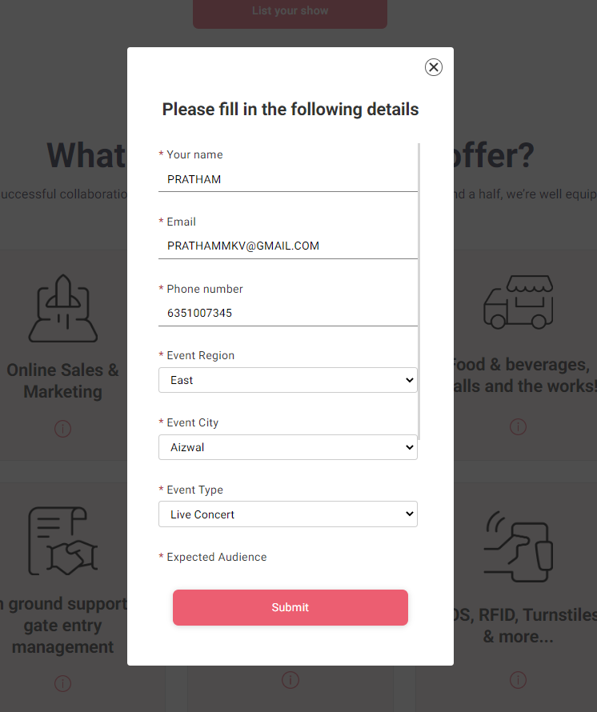
FILLING UP DETAILS
AFTER CONFIRMATION WILL ASK YOU ABOUT DETAILS OF SHOW
JUST LIKE THIS

Slide 32
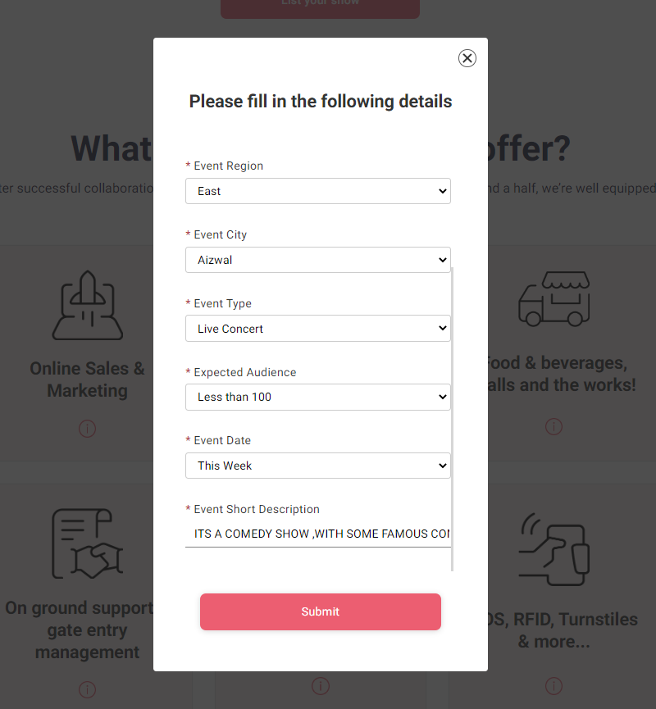
CONTINUE…

Slide 33
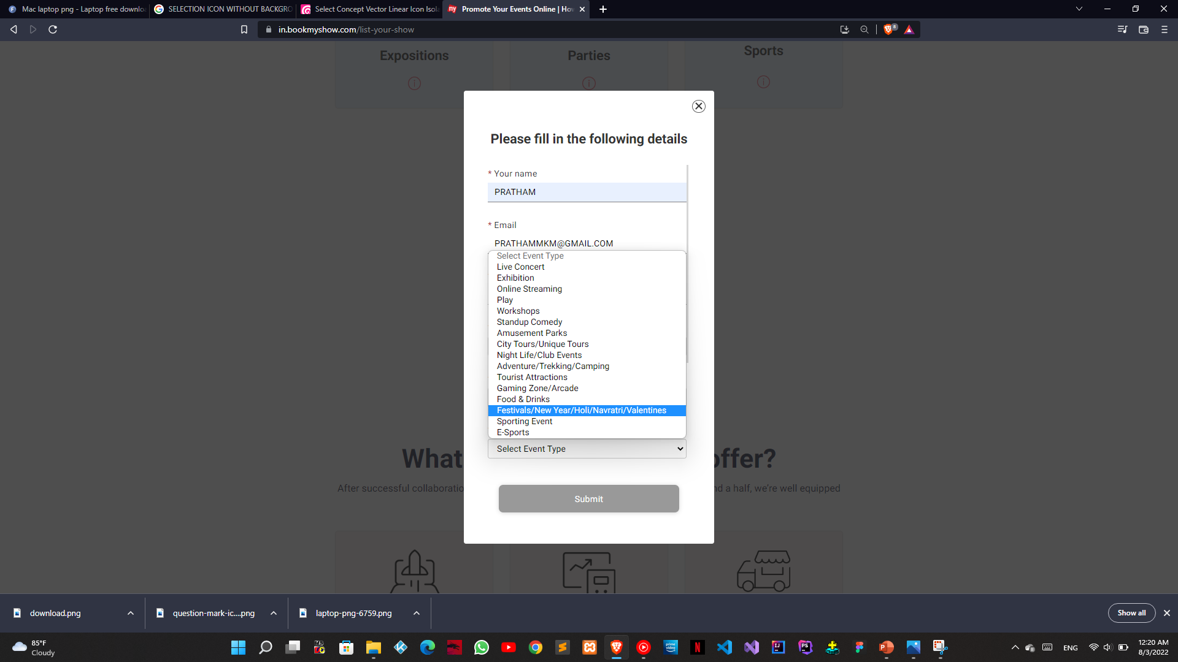
TYPES OF EVENT
VARIOUS TYPES OF EVENT YOU CAN SELECT .

Slide 34
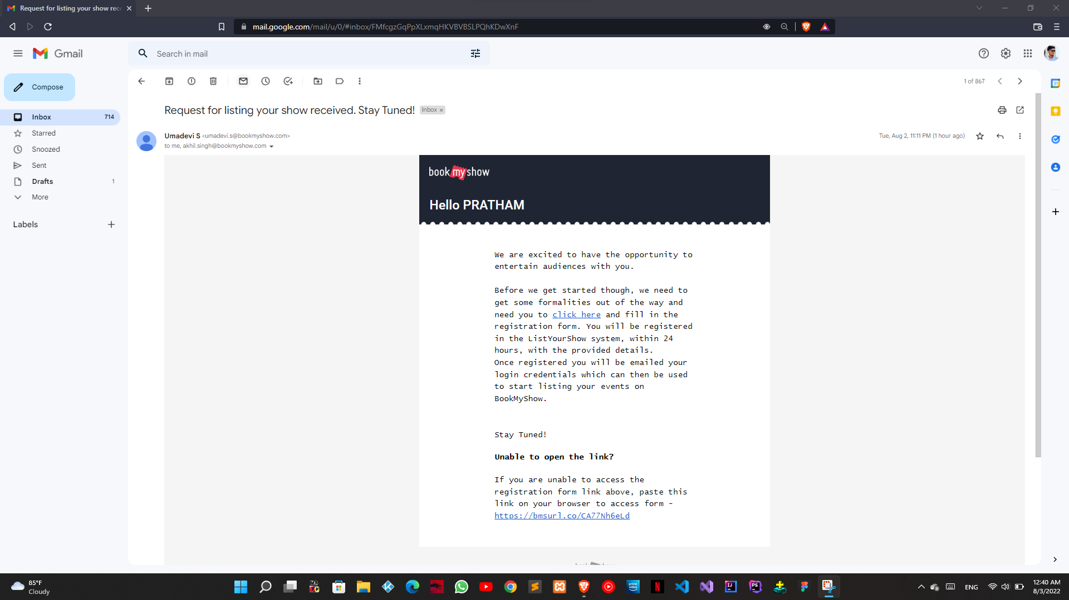
CONFIRMATION EMAIL
AFTER SUBMITING THE DETAILS YOU WILL GET AN CONFIRMATION EMAIL ON YOUR REGIDTERD MAIL ID .

Slide 35
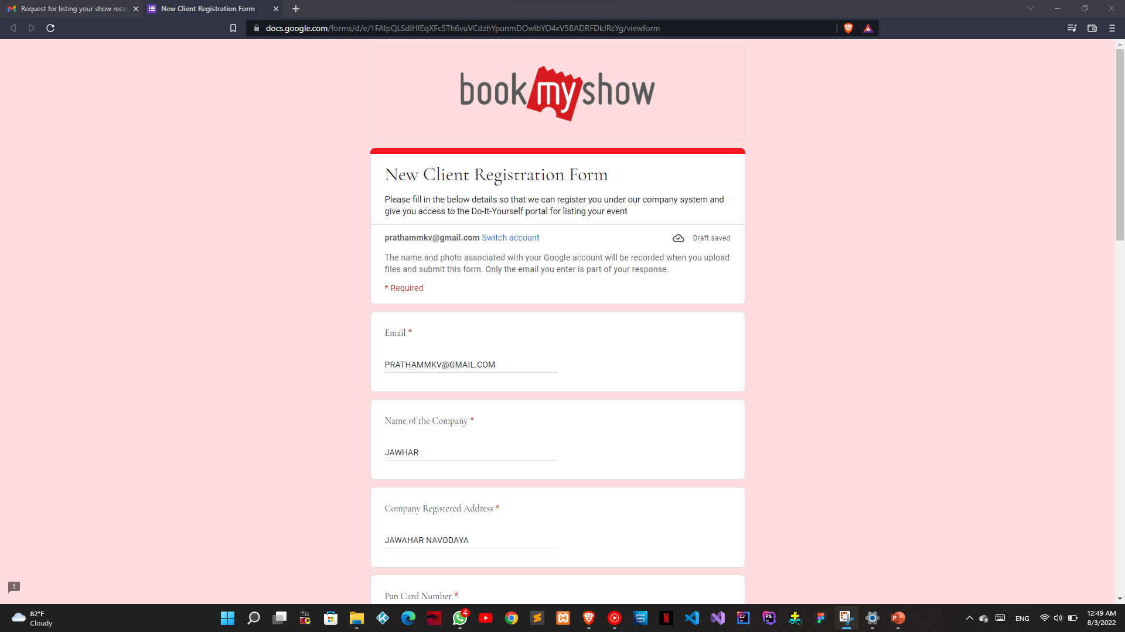
GOOGLE FORM
AFTER FILLING UP THE GOOGLE FORM . YOU WILL BE GOOD TO GO .
AFTER VERIFICATION YOU WILL BE REGISTERD SUCCESSFULLY

Slide 36
Advantages :
stress-free, hustle free booking of tickets
Easy payment options
Various additional schemes to avail on dis booking
Supply when you have an account of site firm where u r doing booking
You can have various options while choosing our tickets

Slide 37
Disadvantages :
software glitch can cause you buy same ticket twice. And then u have to contact Cust care and stress ourself for reversal
Unfortunate network loss while paying online can leave you in confusion whether u have paid or have to Again contact Cust care.
Some time you do online booking but still you have to take trouble collecting those printed passes.

Slide 38


